Slide 1
CSE 445 Project Proposal
By
Tanjil Mahmud 1821458042
Md Abir Hossain 1731597
Emamul Hassan 1731250

Slide 2
Project Proposal
Proposal 1 – Heart Disease Detection
Proposal 2 – Diabetes Detection

Slide 3
Heart Disease Prediction
Goals:
A classification problem
The target is to find presence of heart disease in a patient according to some medical data
An integer value of 0 will show the patient doesn’t have heart disease and 1 will show the patient has heart disease

Slide 4
Heart Disease Prediction(Dataset)
https://archive.ics.uci.edu/ml/datasets/heart+disease
Aka Cleveland dataset, one of the first dataset that ML researchers have used, published in 1988
This dataset has 14 attributes refined from original 76 columns
It has more than 300 rows with no missing values
https://www.kaggle.com/dileep070/heart-disease-prediction-using-logistic-regression
Aka Framingham dataset, shows whether a patient has 10 year risk of future coronary disease.
It has 4000 rows of data and 16 attributes

Slide 5
Heart Disease Prediction(Related Work)
Detrano, R., Janosi, A., Steinbrunn, W., Pfisterer, M., Schmid, J., Sandhu, S., Guppy, K., Lee, S., & Froelicher, V. (1989). International application of a new probability algorithm for the diagnosis of coronary artery disease. American Journal of Cardiology, 64,304--310.
An international attempt was taken to test the model that was applied to estimate angiographic coronary heart disease in Cleveland Clinic, Ohio. The model ran their tests on 3 patient groups from Budapest, Zurich and Basel and California. The algorithm over predicted the probability of heart disease in Budapest and California centers. This paper concluded that heart disease possibility derived from discriminant functions are reliable and clinically useful when applied to patients with chest pain syndromes and intermediate disease prevalence.

Slide 6
Heart Disease Prediction(Related Work)
David, W., Kibler, D. (1988) .Instance-based prediction of heart-disease presence with the Cleveland database. University of California
This paper provided an instance-based prediction of heart-disease presence with the Cleveland database having C4: 74.8% accuracy.

Slide 7
Diabetes Prediction
Goals:
A classification problem
The target is to find presence of Diabetes in a patient
An integer value of 0 will show the patient doesn’t have diabetes and 1 will show the patient has diabetes

Slide 8
Diabetes Prediction(Dataset)
https://www.kaggle.com/uciml/pima-indians-diabetes-database
An all female dataset with 8 attributes and 768 rows
There are some missing values
https://archive.ics.uci.edu/ml/datasets/Early+stage+diabetes+risk+prediction+dataset.
A dataset of 17 attributes with 520 rows, there are some missing values
Collected from Sylhet Diabetes Hospital, Bangladesh

Slide 9
Diabetes Prediction (Related Work)
Mujumdar, Aishwarya & Vaidehi, V.. (2019). Diabetes Prediction using Machine Learning Algorithms. Procedia Computer Science. 165. 292-299. 10.1016/j.procs.2020.01.047. .
Diabetes Mellitus is among critical diseases and lots of people are suffering from this disease. Age, obesity, lack of exercise, hereditary diabetes, living style, bad diet, high blood pressure, etc. can cause Diabetes Mellitus. People having diabetes have high risk of diseases like heart disease, kidney disease, stroke, eye problem, nerve damage, etc. Current practice in hospital is to collect required information for diabetes diagnosis through various tests and appropriate treatment is provided based on diagnosis. Big Data Analytics plays an significant role in healthcare industries. Healthcare industries have large volume databases. Using big data analytics one can study huge datasets and find hidden information, hidden patterns to discover knowledge from the data and predict outcomes accordingly. In existing method, the classification and prediction accuracy is not so high. In this paper, we have proposed a diabetes prediction model for better classification of diabetes which includes few external factors responsible for diabetes along with regular factors like Glucose, BMI, Age, Insulin, etc. Classification accuracy is boosted with new dataset compared to existing dataset. Further with imposed a pipeline model for diabetes prediction intended towards improving the accuracy of classification.

Slide 10
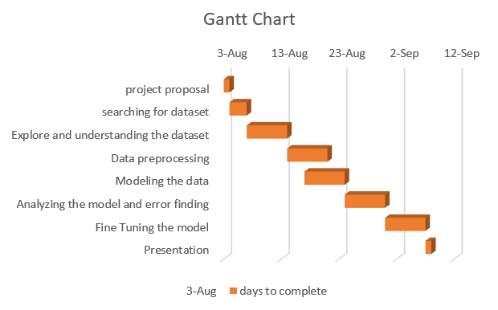
Workflow

Slide 11
Contribution
Divide the selected project in 3 parts then each group member should contribute equally.

